Slide 1
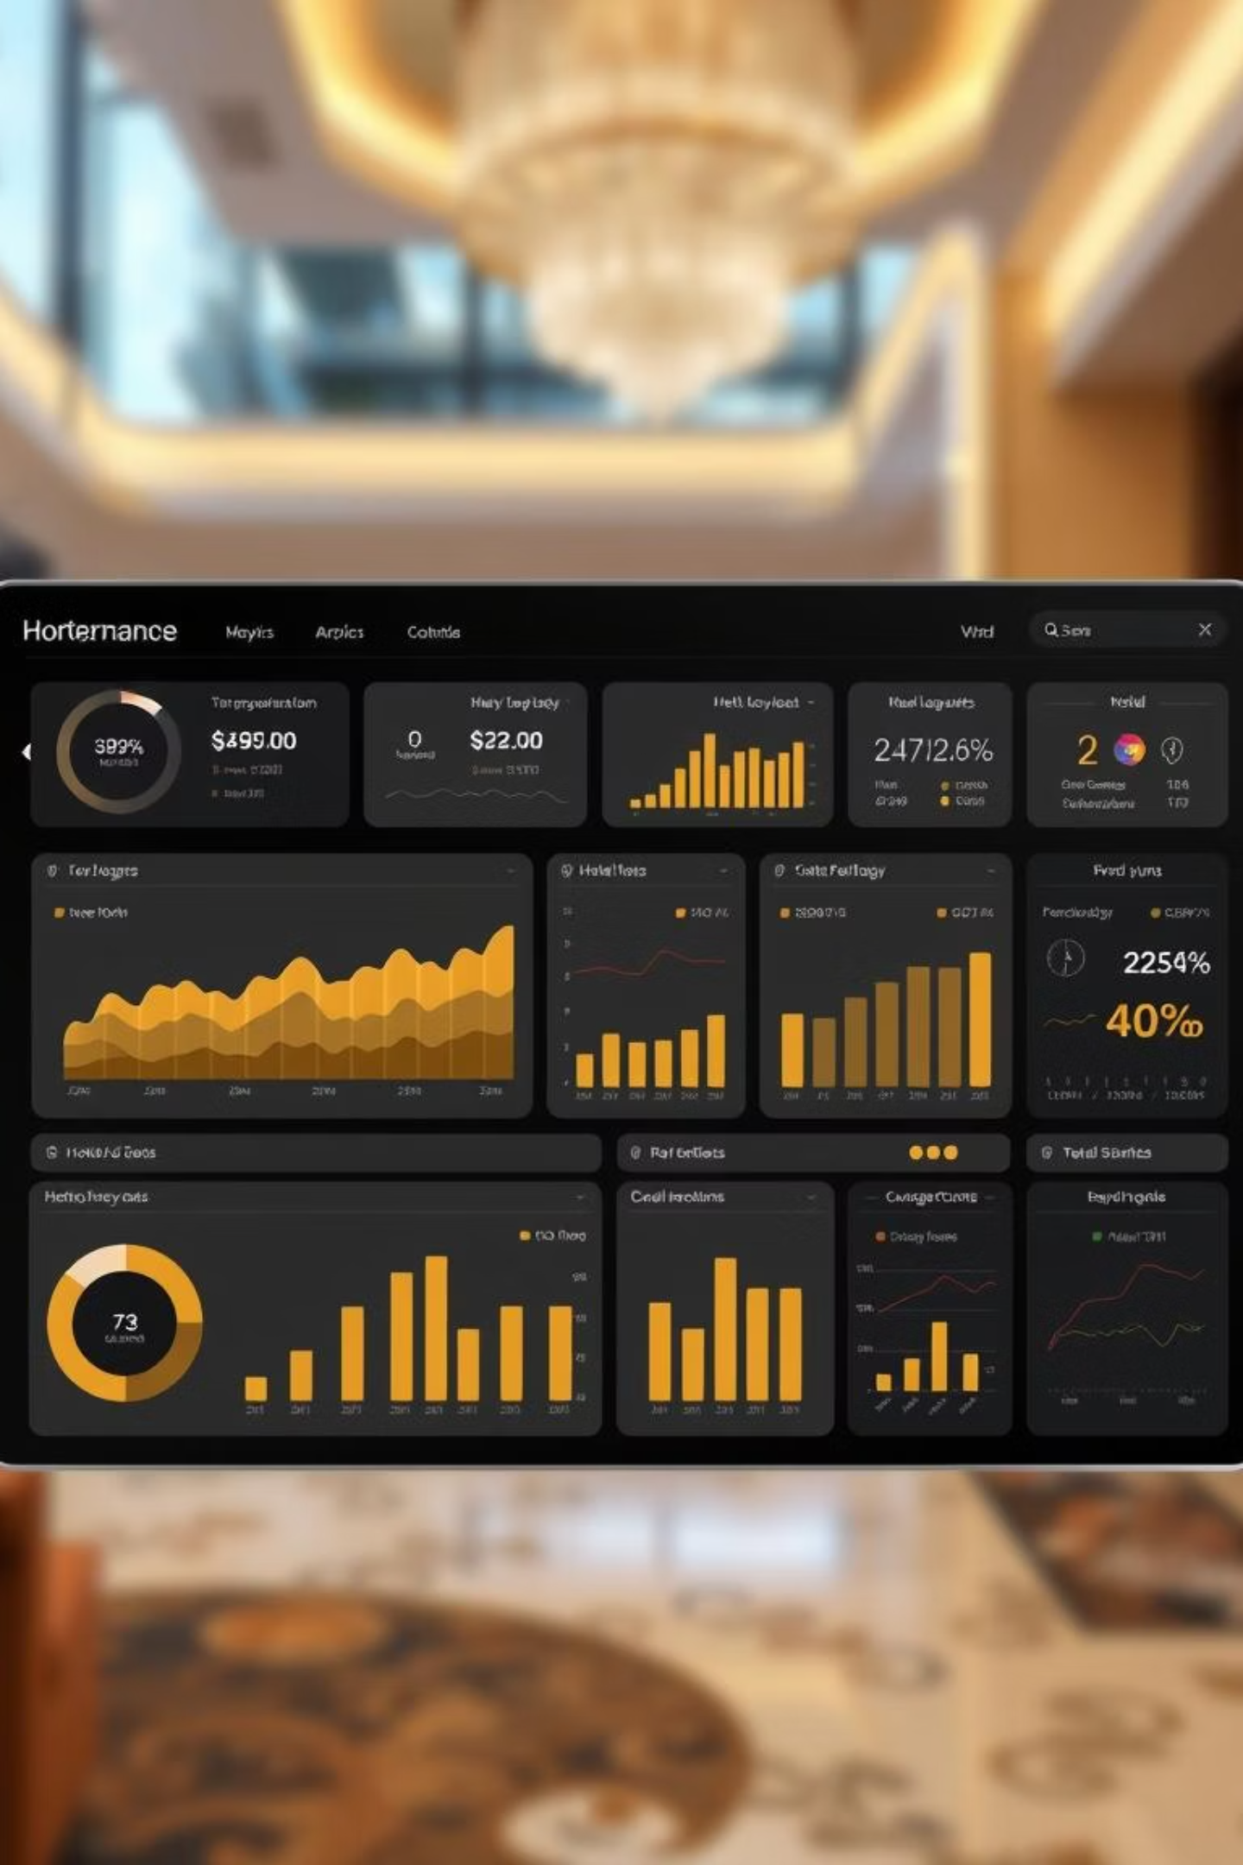
Hotel Performance Dashboard - Trends, Revenue and KPIs
BY : ROHIT GOUDA

Slide 2
INDEX
Problem statements: Unclear Revenue v/s Bookings patterns
Measure taken to reslove the issues
3. Excel Dashboard Overview
4. Detailed Insights Excel
5. Power bi Dashboard Overview
6. Detailed Insights Power bi
7. Tableau Dashboard Overview
8. Detailed Insights Tableau
9. Mysql Overview
10. Detailed Insights Mysql
11. Recommendations
12. Key Metrics to Track
13. Impact of Dashboard Implementation
14. Tools &Technologies Used14.Conclusion

Slide 3

Problem Statement: Unclear Revenue vs Bookings Patterns
Hotels struggle to differentiate weekday vs weekend performance
Class-wise revenue insights are unclear due to scattered data sources
This lack of clarity impacts marketing strategies and pricing decisions.

Slide 4
Steps Taken to Solve the Client's Issue
1. Understood Requirements
Identified key metrics like revenue, bookings, occupancy, cancellations, and trends from client briefs.
2. Data Preparation
Cleaned raw data using Excel formulas (SUMIFS, IF, VLOOKUP) and SQL queries with joins, filters, and groupings.
3. Data Modeling
Built relationships between bookings, hotel, room, and data tables; created DAX measures for utilization %, cancellations, and trends.
4. Dashboard Creation
Excel: Pivot tables, slicers, KPI cards
Power BI: Interactive visuals, filters, and cards
Tableau: Advanced charts, trend lines, city-level visualizations
5. Result
Delivered a comprehensive, visual, and interactive dashboard enabling fast, data-driven decisions.

Slide 5
Excel Dashboard Overview
🔹 The dashboard reports 135K total bookings and ₹1,708.8M revenue, showing strong performance.
🔹 The occupancy rate is 57.87%, while the cancellation rate is 24.83%, highlighting a concern with cancellations.
🔹 Weekdays outperform weekends in both bookings and revenue, indicating a more business-oriented customer base.
🔹 RT3 room category generates the highest revenue, and RT1 has the highest room utilization.
🔹 Mumbai leads in revenue by state, and Atliq Blu & Atliq Exotica are top-performing hotels.
🔹 Monthly trends show peak bookings in June and July, while occupancy has slightly declined over time.

Slide 6
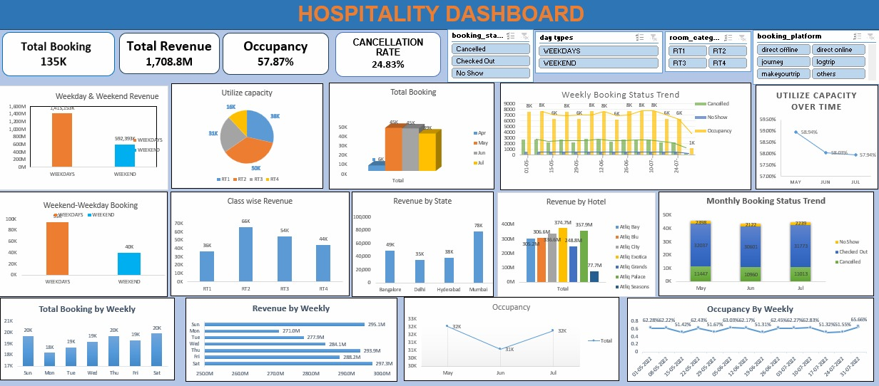
Detailed Insights Excel

Slide 7
Power BI Dashboard Overview
The dashboard shows a total of 135K bookings and 1,709M revenue, reflecting strong overall performance.
The occupancy rate is 57.87%, indicating moderate room utilization.
The cancellation rate is 24.83%, which is relatively high and may need attention.
Mumbai is the top revenue-generating city, and Atliq Exotica is the highest-earning hotel.
Weekday bookings and revenue are significantly higher than on weekends.
RT3 and RT1 room classes generate the most revenue among all room types.
Most guests checked out during June and July, highlighting the seasonal peak.

Slide 8
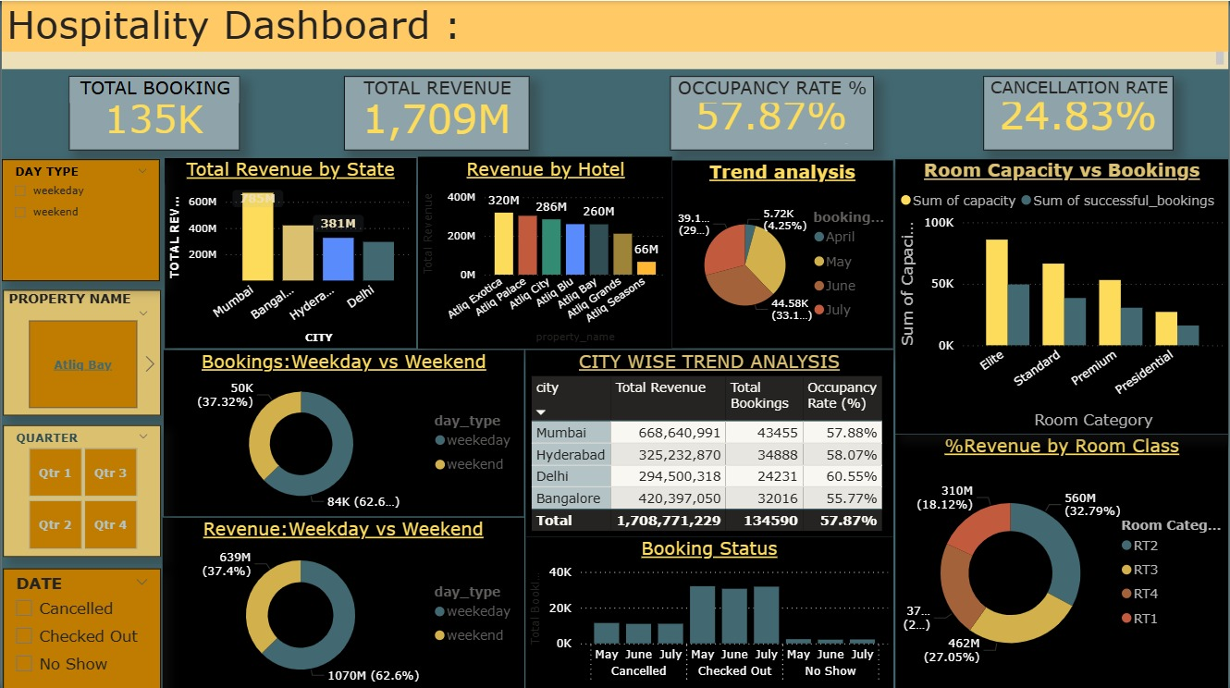
Detailed Insights PowerBI

Slide 9
Tableau Dashboard Overview
🔹 The dashboard shows a total of 135K bookings and ₹1,709M in revenue, with an overall occupancy rate of 57.87%.
🔹 The cancellation rate is 24.83%, with 94K+ guests checked out successfully.
🔹 July had the highest bookings, followed by June, indicating a clear seasonal peak.
🔹 Weekday bookings and revenue are higher than weekends, showing business travel dominance.
🔹 Among room classes, RT2 generated the highest revenue (₹560M).
🔹 Direct offline and journey platforms contributed the most in revenue.

Slide 10
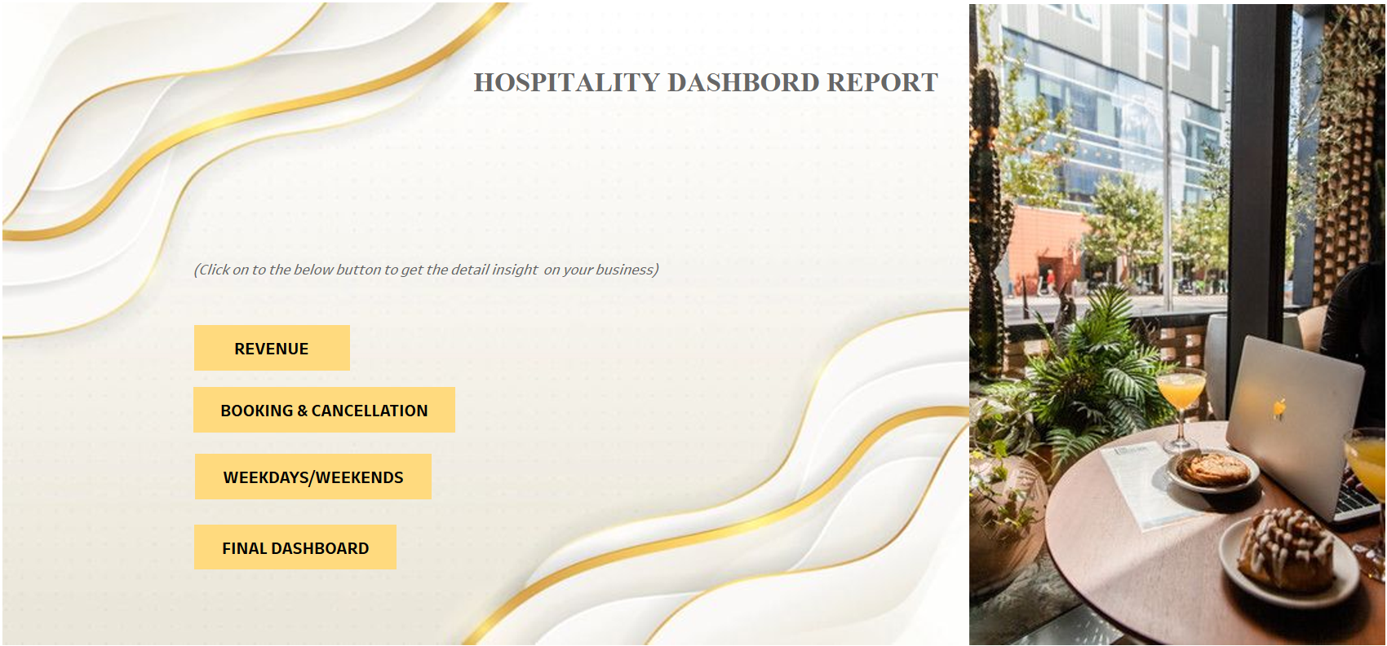
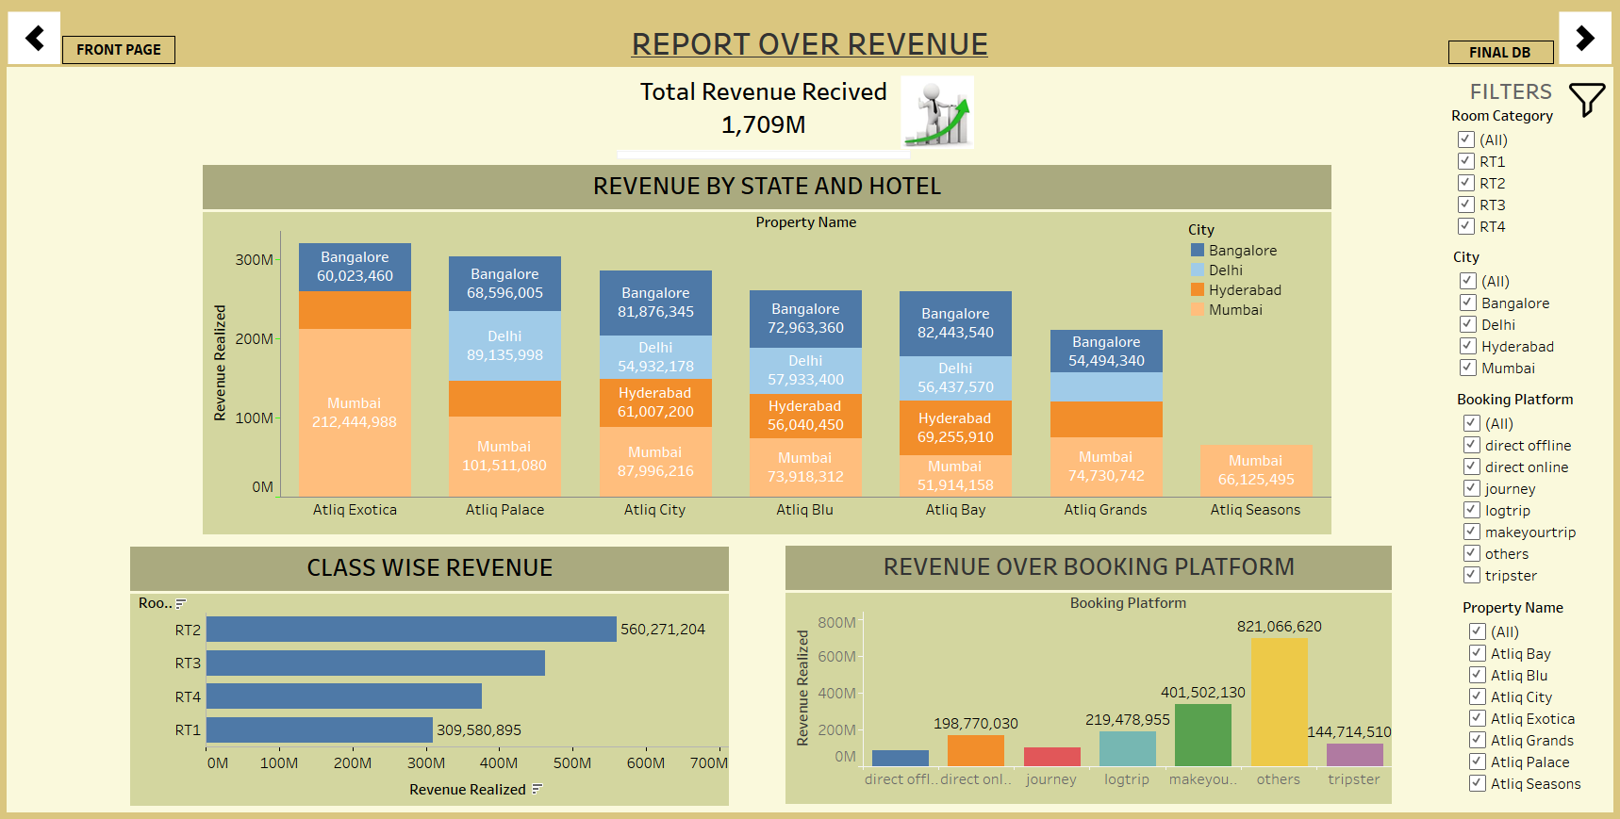
Detailed Insights Tableau

Slide 11
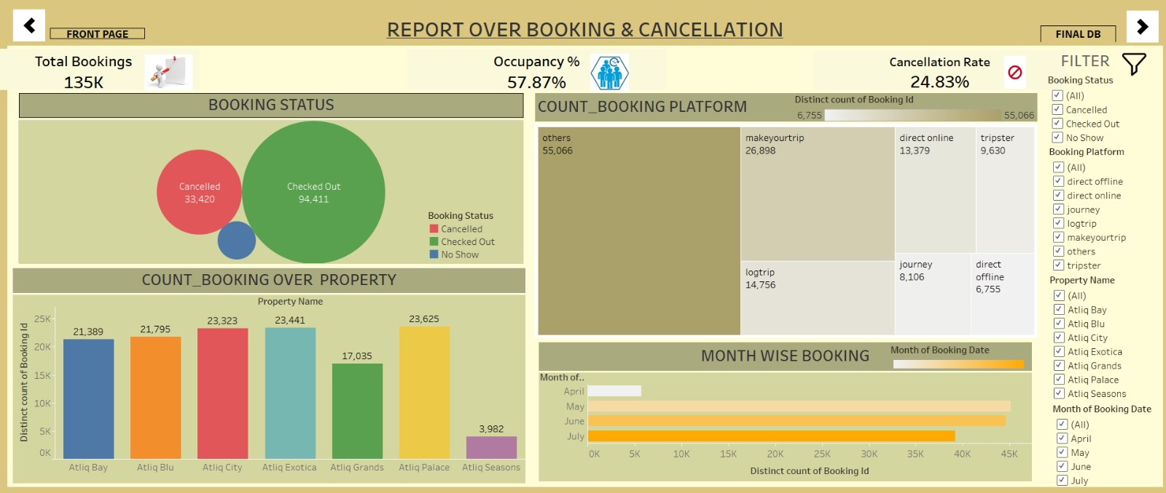
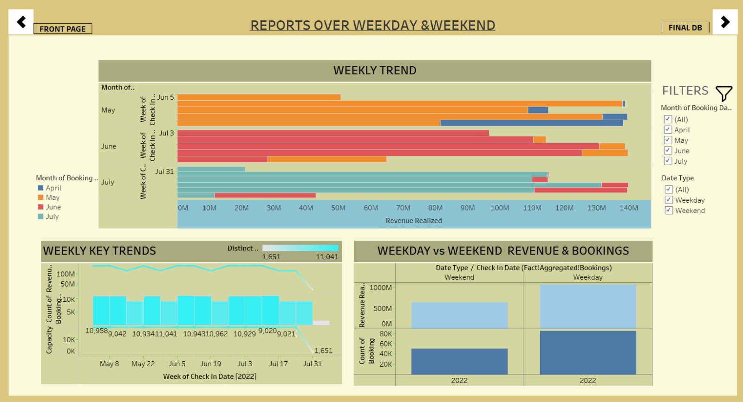

Slide 12
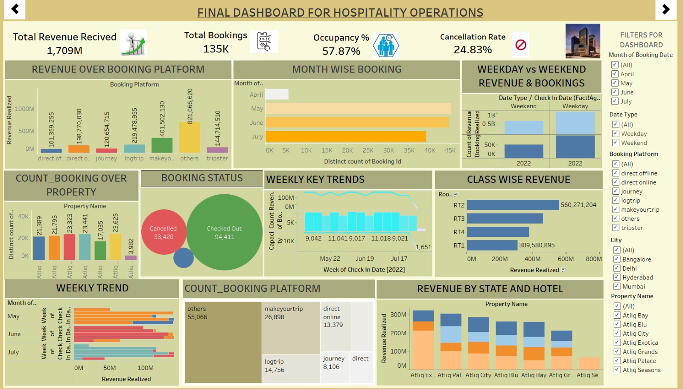

Slide 13
Detailed Insights MySQL
1. Total Revenue
We calculated the total revenue using the sum of all bookings.
This helps us understand how much income the hotels generated overall.
2. Booking Status
We grouped bookings by their status — such as Confirmed, Cancelled, or No-show.
This tells us how customers are interacting with the booking system.
3. Revenue by State & Hotel
We broke down revenue by each state and hotel.
This shows which locations and properties are the highest performers.
4. Occupancy
We calculated how many rooms were actually occupied compared to the total available.
It gives us a clear picture of how efficiently room space is being used.
5. Total Bookings
We counted all bookings made in the system.
This gives us a basic measure of customer activity and demand.

Slide 14
Detailed Insights MySQL
6. Cancellation Rate
We measured the percentage of bookings that were cancelled.
This helps identify problems in customer behavior or the booking process.
7. Class-wise Revenue
We analyzed revenue by room class, like Standard, Deluxe, or Suite.
This tells us which room types are most profitable.
8. Weekly Trend
We looked at how bookings and revenue changed week by week.
It helps identify high and low-performing weeks to guide promotions.
9. Key Trend
We summarized key patterns such as peak seasons or slow periods.
These trends support long-term business planning and forecasting.
10. Weekday & Weekend Revenue & Booking
We compared how bookings and revenue vary between weekdays and weekends.
This shows customer preferences and helps with pricing strategy.

Slide 15
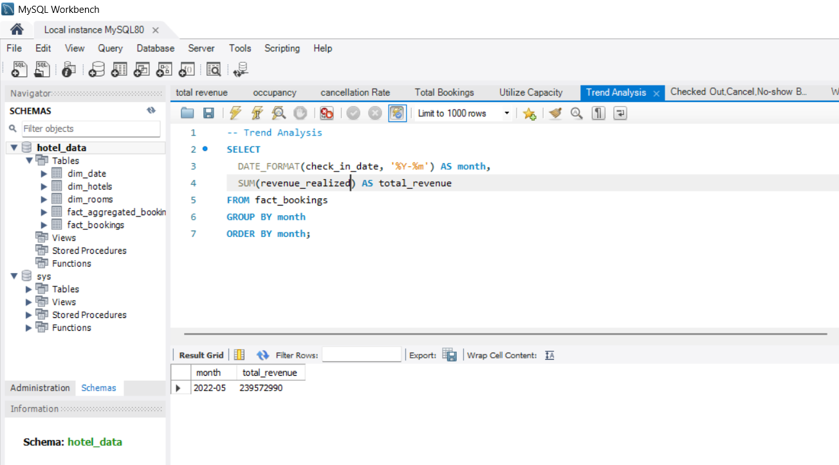
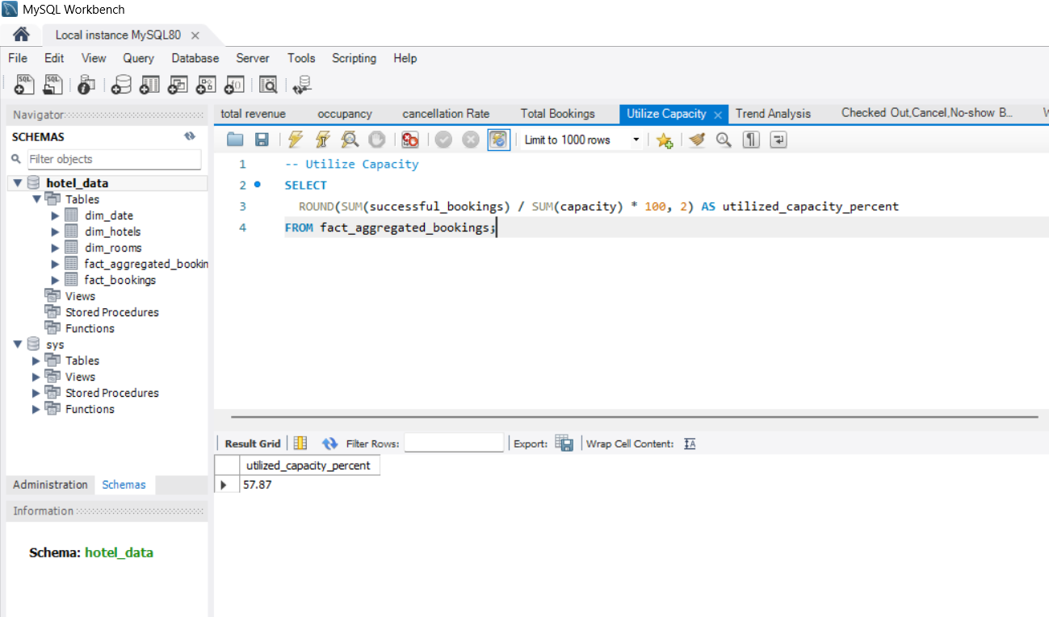
Overview of MySQL

Slide 16
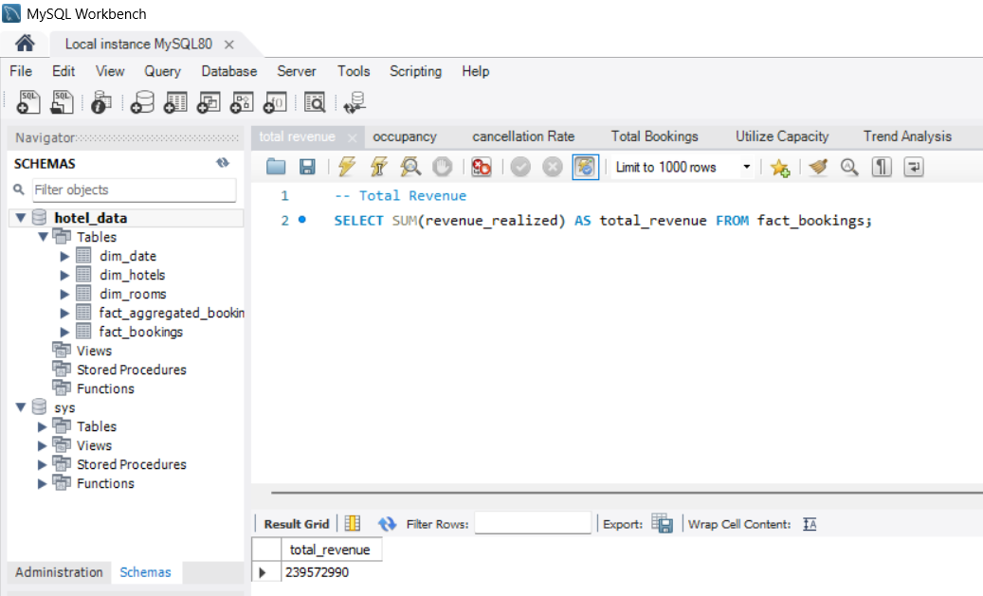
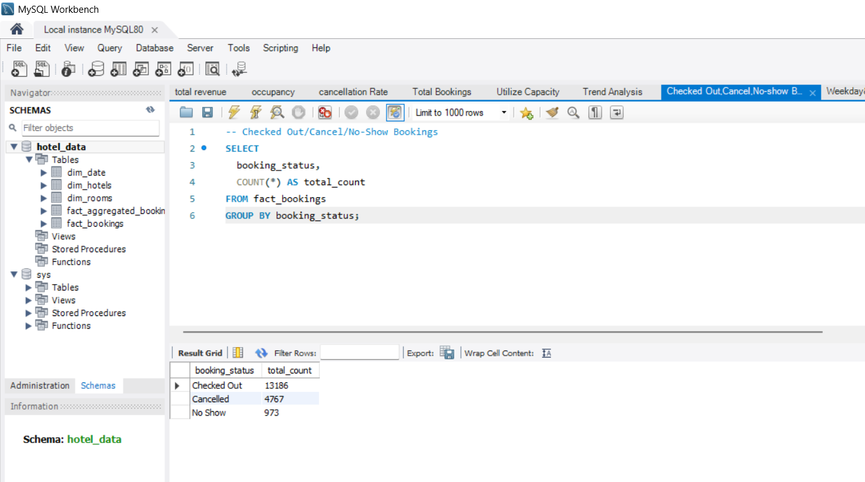

Slide 17
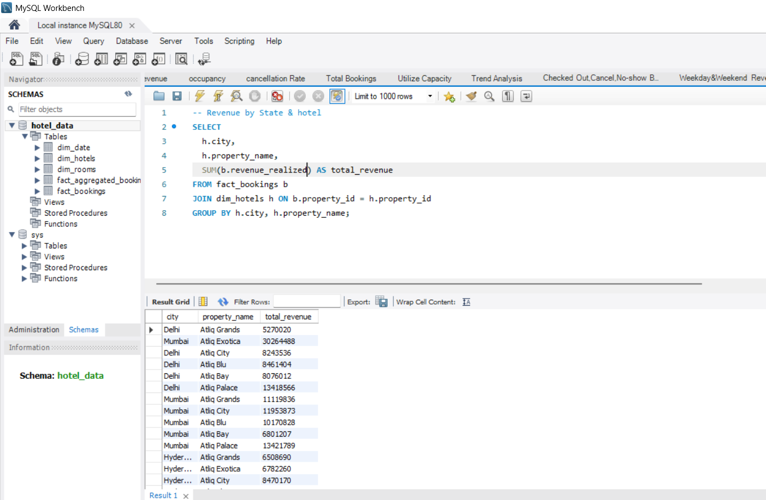
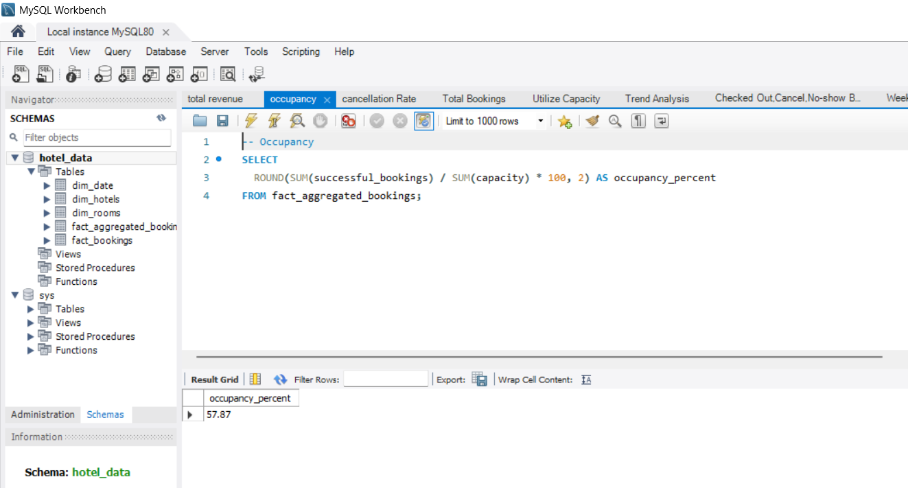

Slide 18
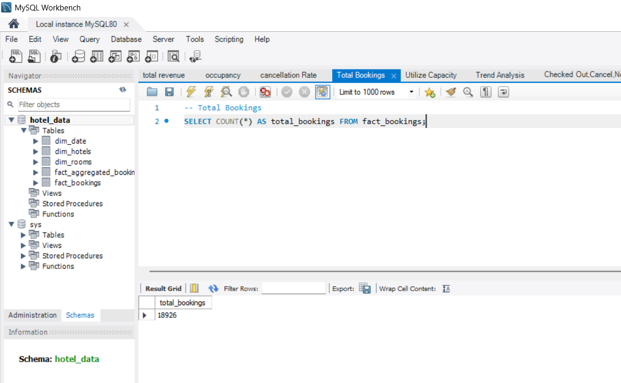
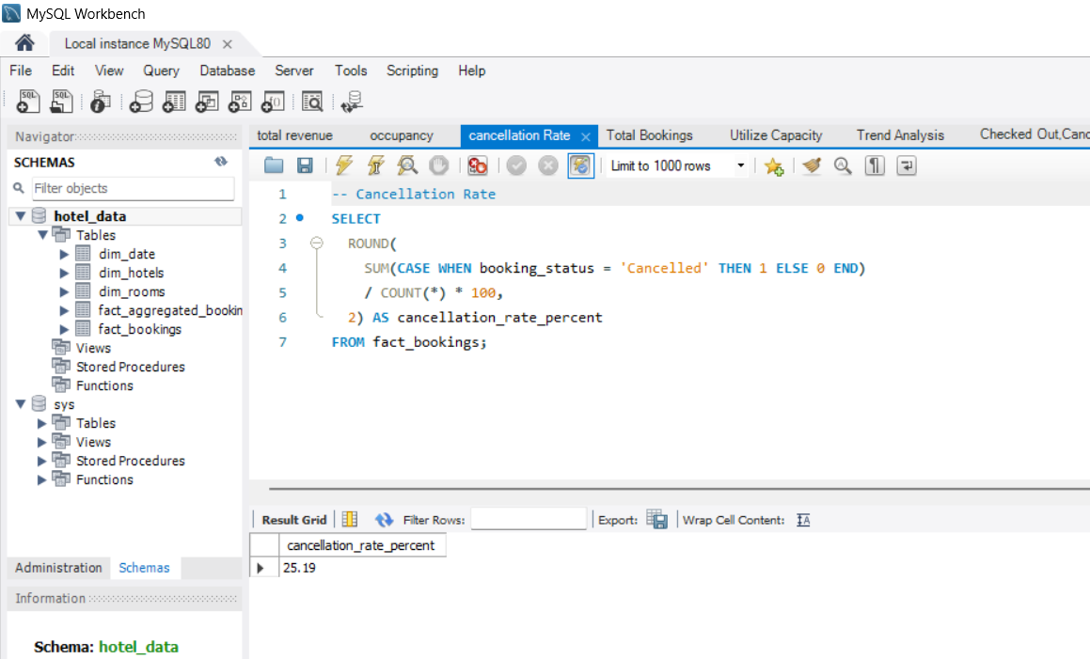

Slide 19
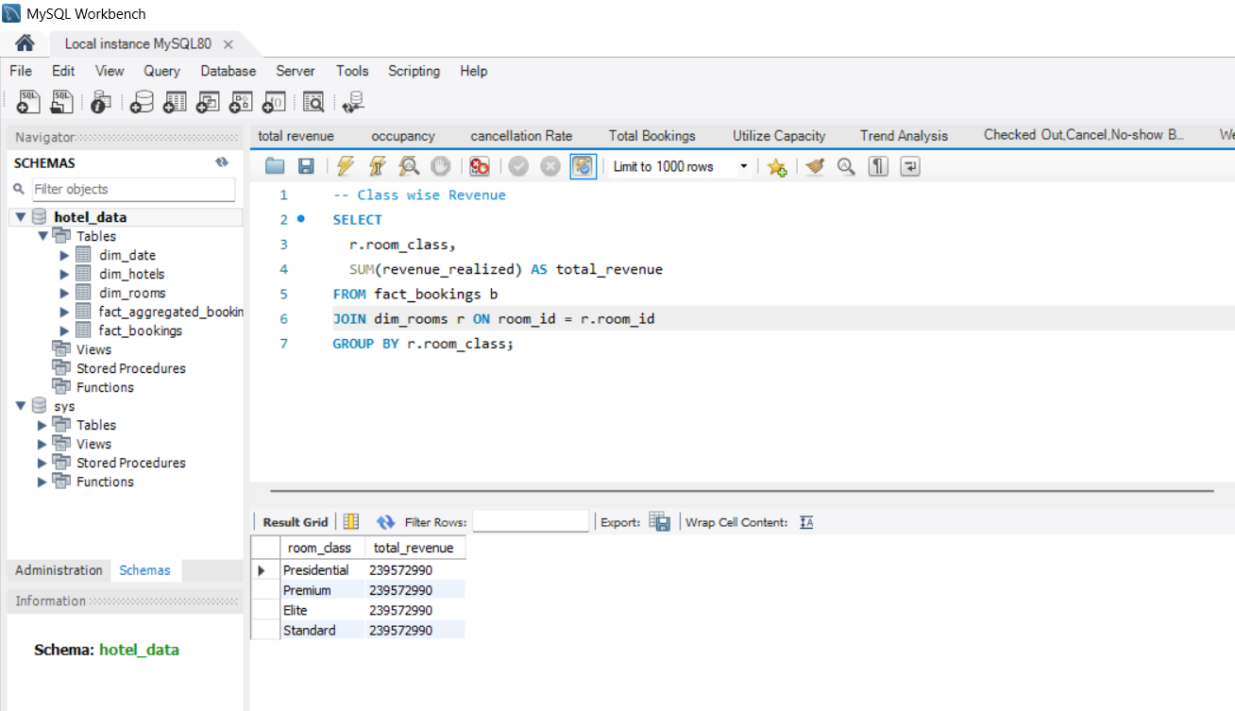
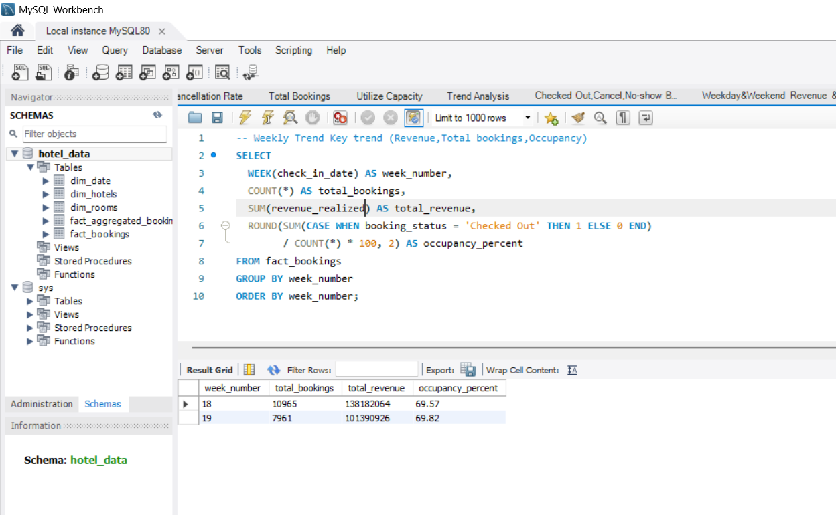
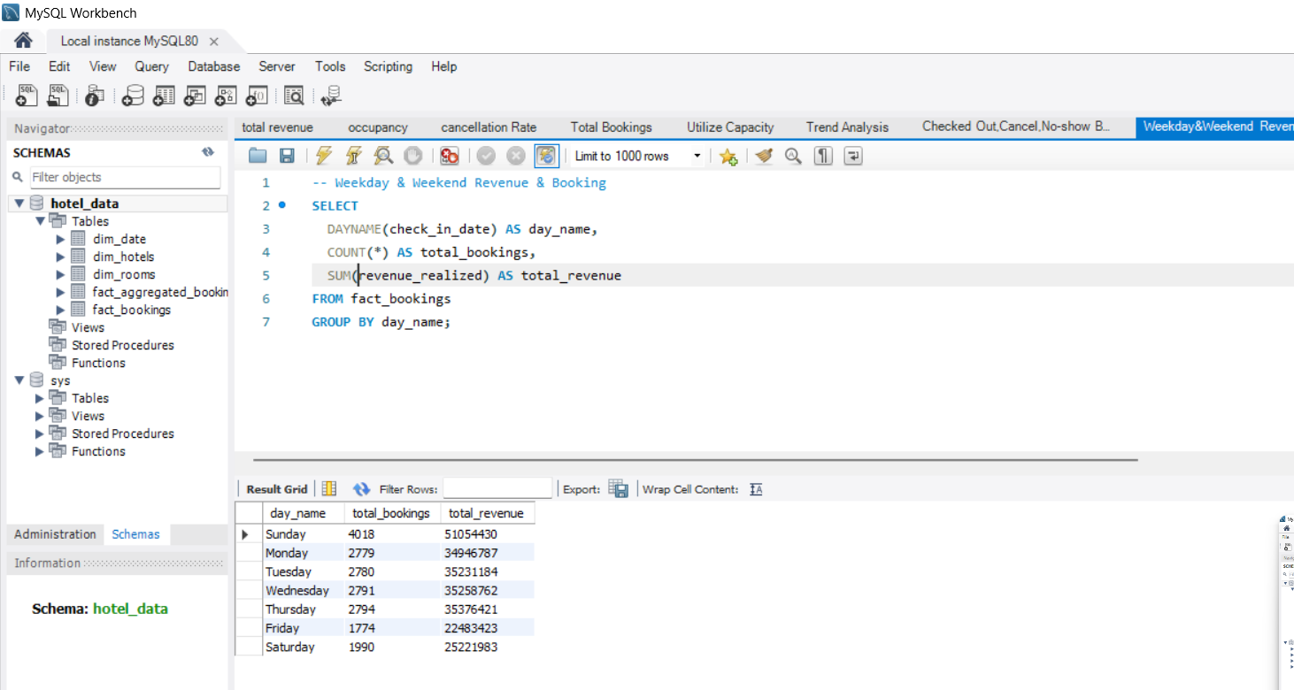

Slide 20

Recommendations
Monitor Key KPIs Weekly: Track occupancy, cancellations, and utilization regularly for timely operational decisions.
Optimize Underutilized Rooms: Use dashboard insights to adjust pricing and marketing for underperforming room types or regions.
Focus on High-Performing Platforms & States: Allocate budget and inventory to booking platforms and regions with consistent high success rates.
Automate Reporting: Use Power BI or Tableau to create live dashboards for real-time decision-making instead of manual Excel updates.

Slide 21




Key Metrics to Track
Occupancy Rate Trends
Cancellation Rates
Weekday vs Weekend Performance
By Room Class and Region
Revenue per Available Room
Utilization Percentage
(RevPAR) by Booking Source
And Booking Lead Time

Slide 22
Impact of Dashboard Implementation
Improved Clarity
Enhanced Decision Making
On revenue streams and booking patterns.
Ability to make data-driven marketing and pricing decisions.
Increased Efficiency
Better Allocation
Operational efficiency through timely KPI monitoring.
Resource allocation leading to revenue growth.

Slide 23


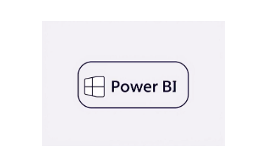

Tools & Technologies Used
Excel
SQL
Power BI
Tableau
Data cleaning and pivot analysis.
Complex data querying and aggregation.
Data modeling and interactive dashboard creation.
Advanced visualization and geographic insights.

Slide 24

Conclusion
Our Hotel Performance Dashboard transforms scattered data into actionable insights, empowering stakeholders to optimize revenue, improve occupancy, and make informed decisions — driving measurable business growth.

